Slide 1
Mesh/Model Data-Oriented Handling, Pipeline

Slide 2
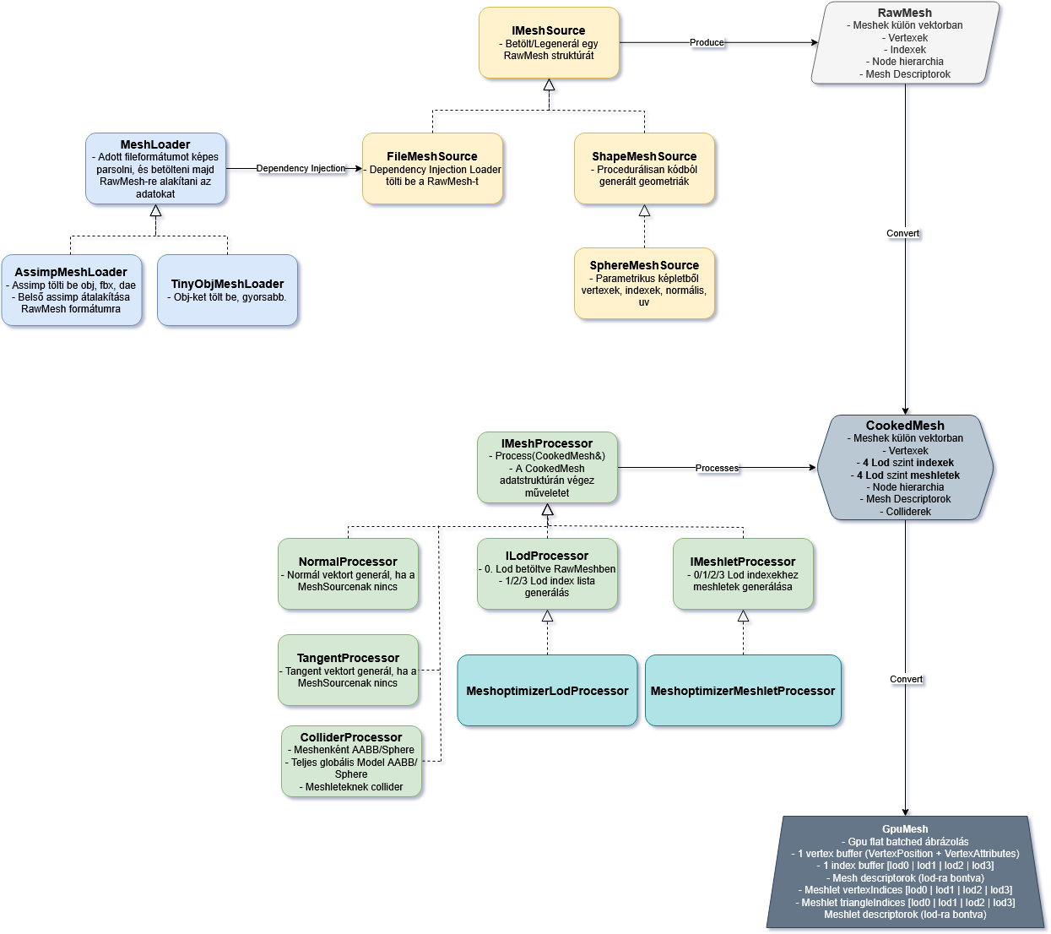
Mesh Handling Layers

Slide 3
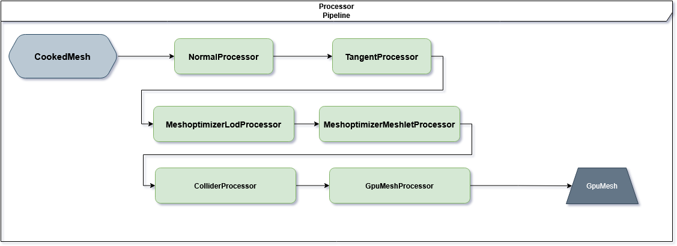
Mesh Processor Pipeline

Slide 4
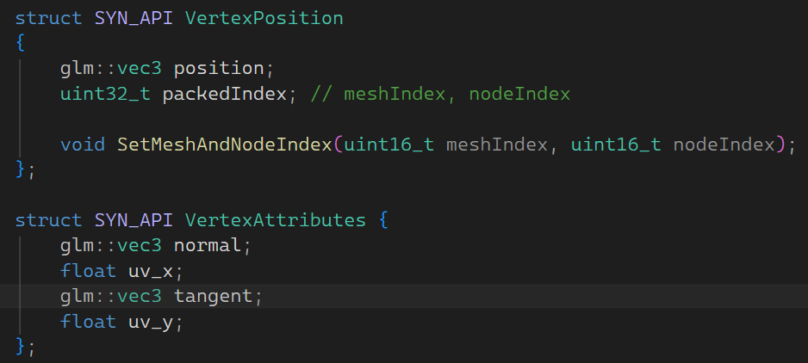
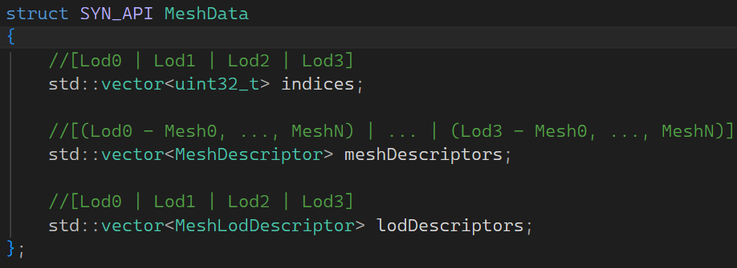
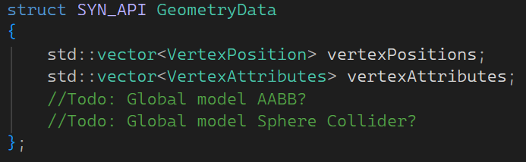
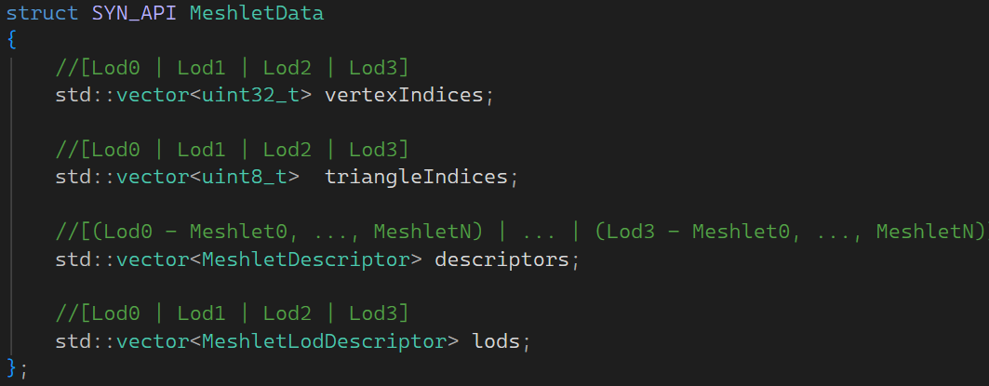
Mesh Data-Oriented Batch Gpu Layout

